Slide 1
C++ Slides - 6
File handling: Formatted I/O, Hierarchy of file stream classes, Opening and closing a file, Working with multiple files, file modes, file pointers, Text vs Binary Files.

Slide 2
Formatting I/O
Set precision
Text justification
Display +/- sign
…

Slide 3



//Formatting example
#include<iostream>
using namespace std;
int main(){
cout<<showpos<<10.1234<<endl; //show +/- sign
cout.precision(4); //total display digits
cout<<-12.34567<<endl;
cout.width(5); // Right justify with 5 char
cout << 'c' <<endl;
}

Slide 4
Output
+10.1234
-12.35
c

Slide 5
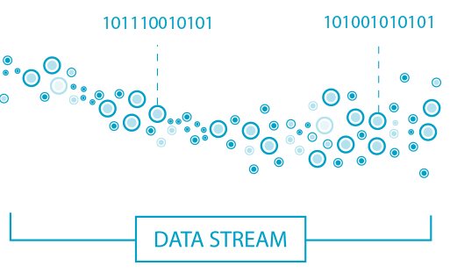
Stream
Stream is the flow of digital data (bytes) as input or output through an abstract device (for example screen or files).

Slide 6
File stream classes
ios - all I/O operations
istream is for input e.g. as getline()
ostream is for output e.g. write()
ifstream – Input from file
ofstream – write to a file
fstream – I/O with a file
Ifstresm = input file stream

Slide 7

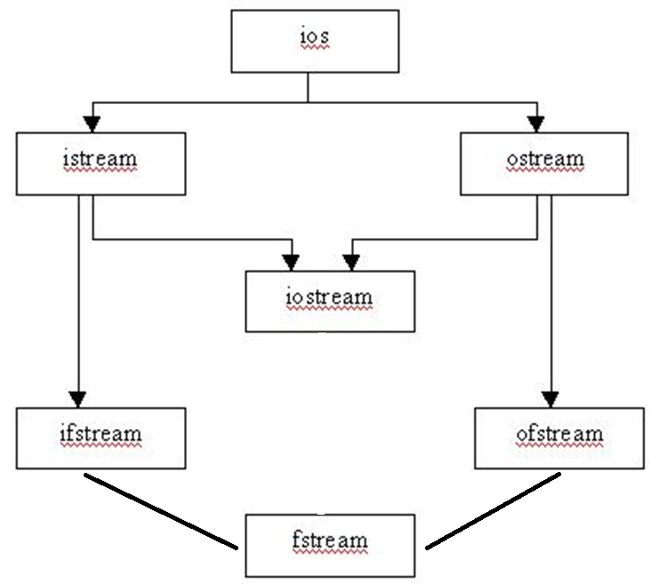

Slide 8
Consider a simple text file MySecrets.txt
This is
a simple text
consisting words
numbers 1234.09872
and symbols !@#$%^&*()

Slide 9































// Read characters from file
#include <iostream>
#include<fstream>
using namespace std;
int main() {
char c;
ifstream fin("MySecrets.txt");
if(!fin) {cout<<"File Does not Exist"; return 0; }
while(!fin.eof()) { // eof – end of the file
fin.get(c); cout<<c; // print text on screen
}
fin.close();}

Slide 10
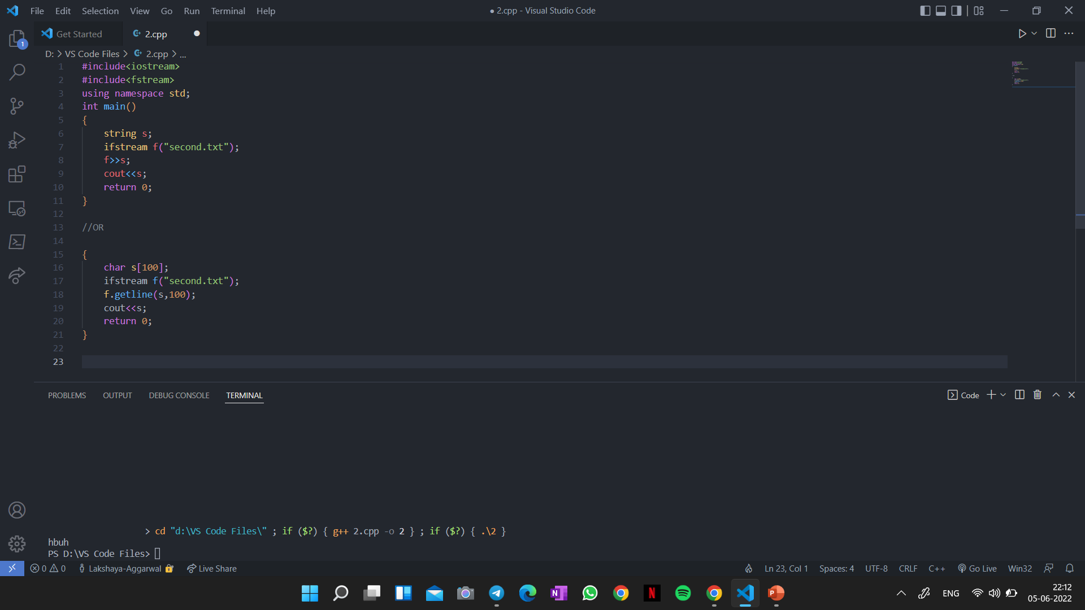

Slide 11
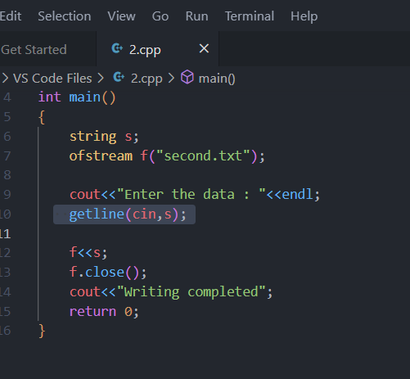
// Writing text into file
#include <iostream>
#include <fstream>
using namespace std;
int main () {
ofstream file("Simplefile.txt");
file << "Writing to a file in C++....";
file.close();
}

Slide 12
Working with multiple files
// MyFile.cpp
int MyValue() {
return -9999;
}
#include “MyFile.cpp”
#include <iostream>
using namespace std;
int main() {
cout<<MyValue();
}

Slide 13
File modes
ios::app – Always write in the end of a file
ios::ate – Take the control at the end just once
ios::in - Open a file for reading
ios::out - Open a file for writing
ios::trunc – remove the old contents

Slide 14
// Writing text into file using ios::out flag
#include <iostream>
#include <fstream>
using namespace std;
int main () {
fstream file("Simplefile.txt“,ios::out);
file << "Writing to a file in C++....";
file.close();
}

Slide 15
// Reading + writing in a file
#include<iostream>
#include<fstream>
using namespace std;
int main(){
string sen;
ofstream fout(“MySecrets.txt”);
fout<<“hello 123”;
fout.close();
ifstream fin(“MySecrets.txt”);
getline(fin, sen); cout<<sen;
fin.close();
}

Slide 16
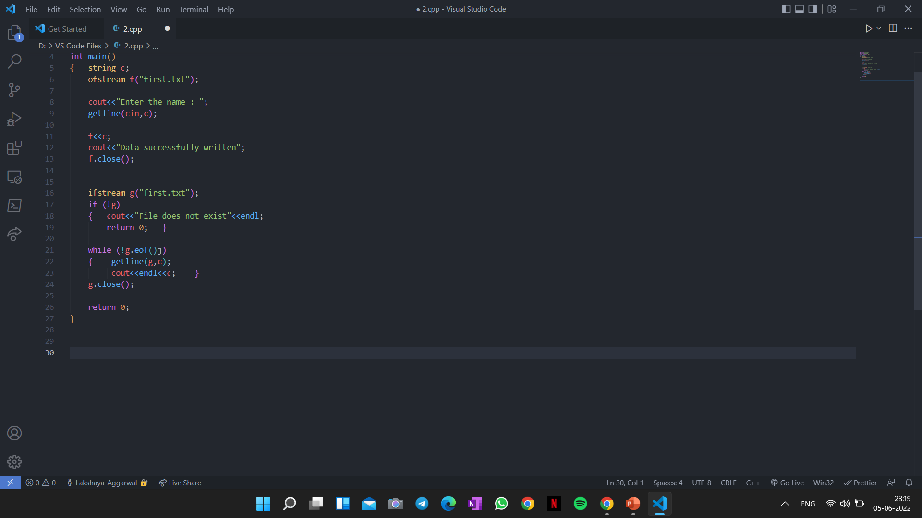

Slide 17
Q:Try to read and write a file using ios::in and ios::out
Hint:
fstream fileIO(“MySecrets.txt”,ios::in,ios::out);
You may need file pointers such as seek() and tell() functions which are covered next.

Slide 18


Slide 19
File pointers – bookmarks in the file
Get Pointer tells the current location during file reading
Put Pointer tells the current position during file writing
A file pointer is not like a C++ pointer but works like a book-mark in a book
These pointers help attain random access in file for faster access in comparison to a sequential access

Slide 20
File pointers – seek and tell
Tell function - just examine the file location
Seek function – actually set the bookmark in a file

Slide 21
G and P in – seekg(), tellg(), seekp(), tellp()
G – (as Get) is for file read operation
P – (as Put) is for file write operation

Slide 22
File pointers – seekg(), tellg(), seekp(), tellp()
seekg() and tellg() functions allow you to set and examine the get_pointer in the given file
seekp() and tellp() functions perform these operations on the put_pointer.

Slide 23









Current, beginning and & end
References for seek and tell functions
ios::beg
ios:cur
ios:end

Slide 24




Few examples
fin.seekg(30); or fin.seekg(30, ios::beg);
// go to byte no. 30 from beginning of file
fin.seekg(-2, ios::cur); // back up 2 bytes from the current position of get pointer
fin.seekg(-4, ios::end); // backup 4 bytes from the end of the file

Slide 25
Text vs Binary Files
In text files various character translations are performed such as “\r+\f” is converted into “\n”, whereas in binary files no such translations are performed.
By default, C++ opens the files in text mode.

Slide 26


Text files versus Binary files
ofstream out (“myfile.txt”);
Storage is more e.g. floating point numbers (IEEE 754) 12345.1234 will take 10 char bytes.
Access is slower using sequential search
ofstream out (“myfile.txt”,ios::binary);
Memory efficient for storage.
Each binary file maintains a header of content index for faster search as compared to text files. More info is required but access is faster.

Slide 27











Useful codes for file programs
// how to count characters in a file
int count = 0; char ch; while(!fin.eof()) { fin.get(ch); count++; }
// how to count words in a file
int count = 0; char word[30]; while(!fin.eof()) { fin >> word; count++; }
// how to count lines in a file
int count = 0; char str[80];
while(!fin.eof()) { fin.getline(str,80); count++; }

Slide 28
// Copy contents of one file into another
#include<iostream>
#include<fstream>
using namespace std;
int main() {
char ch;
ifstream fin("MySecrets.txt");
ofstream fout("CopyMySecrets.txt");
while(!fin.eof()) {
fin.get(ch);
fout << ch;
}
fin.close(); fout.close();
}

Slide 29
Text file | Binary File
The text files can easily be transferred from one computer system to another. | Binary files cannot easily be transferred from one computer system to another due to variations in the internal variations in the internal representation which varies from computer to computer.
It stores data using ASCII format i.e. human-readable graphic characters. | It stores data in binary format i.e. with the help of 0 and 1.
These files are easily readable and modifiable because the content written in text files is human readable. Content written in binary files is not human-readable and looks like encrypted content. | These files are not easily readable and modifiable because the content written in binary files is not human-readable and it is encrypted content.
These files create portability problems. | These files are easily portable.
Text files save the data by converting each digit in data into ASCII format which will take up much of the space as compared to the required one. For example, the number 546378 is an integer that should occupy 4 bytes in the disk but it will occupy 6 bytes, 1 byte for each digit in the number. | These save memory because the data of any type will get stored in memory as per its memory size. For example, any integer number irrespective of individual digits in the number will be stored by consuming 4 bytes.
Any file is by default text file. | The ios:: binary mode has to be used with binary files while opening them.
Error in a textual file can be easily recognized and eliminated. | Error in a binary file corrupts the file and is not easily detected.
In a text file, a new line character is first converted to a carriage return-line feed combination and then written to the disk. Vice versa happens when a line is read from the text file. | In binary file, no such conversion from newline to carriage return-line feed combination is done.
In a text file, a special character with ASCII code 26 is inserted at the end of the file. This character signals the EOF to the program when encountered. | There is no such special character in the binary file to signal EOF.

